Slide 1
1:13-25

Slide 2
1:13-25
1 Cor. 11:10 ~ For this reason the woman ought to have a symbol of authority on her head, because of the angels.
1 Peter 2:12 ~ (have) your conduct honorable among the Gentiles, that when they speak against you as evildoers, they may, by your good works which they observe, glorify God …

Slide 3
1:13-25

Slide 4
1:13-25
1 Peter 2:13-25 ~ ¹³ Therefore submit yourselves to every ordinance of man for the Lord’s sake, whether to the king as supreme, ¹⁴ or to governors, as to those who are sent by him for the punishment of evildoers and for the praise of those who do good. ¹⁵ For this is the will of God, that by doing good you may put to silence the ignorance of foolish men — ¹⁶ as free, yet not using liberty as a cloak for vice, but as bondservants of God. ¹⁷ Honor all people. Love the brotherhood. Fear God. Honor the king.

Slide 5
1:13-25
1 Peter 2:13-25 ~ ¹⁸ Servants, be submissive to your masters with all fear, not only to the good and gentle, but also to the harsh. ¹⁹ For this is commendable, if because of conscience toward God one endures grief, suffering wrongfully. ²⁰ For what credit is it if, when you are beaten for your faults, you take it patiently? But when you do good and suffer, if you take it patiently, this is commendable before God. ²¹ For to this you were called, because Christ also suffered for us, leaving us an example, that you should follow His steps:

Slide 6
1:13-25
1 Peter 2:13-25 ~ ²² “Who committed no sin,
Nor was deceit found in His mouth”;
²³ who, when He was reviled, did not revile in return; when He suffered, He did not threaten, but committed Himself to Him who judges righteously; ²⁴ who Himself bore our sins in His own body on the tree, that we, having died to sins, might live for righteousness—by whose stripes you were healed. ²⁵ For you were like sheep going astray, but have now returned to the Shepherd and Overseer of your souls.

Slide 7
1:13-25

Slide 8
1:13-25
Once upon a time, a perfect man and a perfect woman met. After a perfect courtship, they had a perfect wedding. Their life together was, of course, perfect.
One snowy, stormy Christmas Eve, this perfect couple was driving their perfect car along a winding road when they noticed someone at the side of the road in distress.
Being the perfect couple, they stopped to help.
There stood Santa Claus with a huge bundle of toys.
Not wanting to disappoint any children on the eve of Christmas, the perfect couple loaded Santa
and his toys into their vehicle.

Slide 9
1:13-25
Soon they were driving along delivering the toys.
Unfortunately, the driving conditions deteriorated and the perfect couple and Santa Claus had an accident.
Only one of them survived the accident.

Slide 10
1:13-25
Question: Who was the survivor?
(Scroll down for the answer)
So, if there is no perfect man and no Santa Claus, the woman must have been driving.
This explains why there was a car wreck in the first place.
Answer: The perfect woman survived. She’s the only one in the story who really ever existed.
Everyone knows there is no Santa Claus and there is no such thing as a perfect man.

Slide 11
1:13-25

Slide 12
1:13-25
every ~ pas – all, any, the whole
ordinance of man ~ literally, man-made institution

Slide 13
1:13-25

Slide 14
1:13-25
silence ~ phimoō – to muzzle
1 Cor. 9:9 ~ For it is written in the law of Moses, “You shall not muzzle an ox while it treads out the grain.”
Luke 4:35 ~ But Jesus rebuked him, saying, “Be quiet, and come out of him!” And when the demon had thrown him in their midst, it came out of him and did not hurt him.

Slide 15
1:13-25
silence ~ phimoō – to muzzle
Mark 4:39 ~ Then He arose and rebuked the wind, and said to the sea, “Peace, be still!” And the wind ceased and there was a great calm.

Slide 16
1:13-25

Slide 17
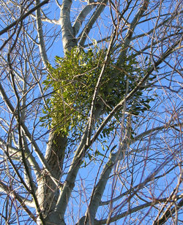
1:13-25
Mistletoe

Slide 18
1:13-25
A B C D E F G H I J K L M N O P Q R S T U V W X Y Z
1 2 3 4 5 6 7 8 9 10 11 12 13 14 15 16 17 18 19 20 21 22 23 24 25 26
H – A – R – D – W – O – R - K
= 98%
8 + 1 + 18 + 4 + 23 + 15 + 18 + 11

Slide 19
1:1-12
A B C D E F G H I J K L M N O P Q R S T U V W X Y Z
1 2 3 4 5 6 7 8 9 10 11 12 13 14 15 16 17 18 19 20 21 22 23 24 25 26
K-N-O-W-L-E-D-G-E
= 96%
11+14+15+23+12+5+4+7+5

Slide 20
1:13-25
A B C D E F G H I J K L M N O P Q R S T U V W X Y Z
1 2 3 4 5 6 7 8 9 10 11 12 13 14 15 16 17 18 19 20 21 22 23 24 25 26
A – T – T – I – T – U – D - E
= 100%
1+20+20+9+20+21+4+5

Slide 21
1:13-25
Charles Swindoll ~ “The longer I live, the more I realize the impact of attitude on life.
“Attitude, to me, is more important than facts. It is more important than the past, than education, than money, than circumstances, than failures, than successes, than what other people think or say or do. It is more important than appearance, giftedness or skill. It will make or break a company ... a church ... a home.
“The remarkable thing is we have a choice every day regarding the attitude we will embrace for that day. We cannot change our past ...

Slide 22
1:13-25
Charles Swindoll ~ we cannot change the fact that people will act in a certain way. We cannot change the inevitable. The only thing we can do is play on the one string we have, and that is our attitude ... I am convinced that life is 10% what happens to me and 90% how I react to it.
“And so it is with you ... we are in charge of our attitudes.”

Slide 23
1:13-25

Slide 24
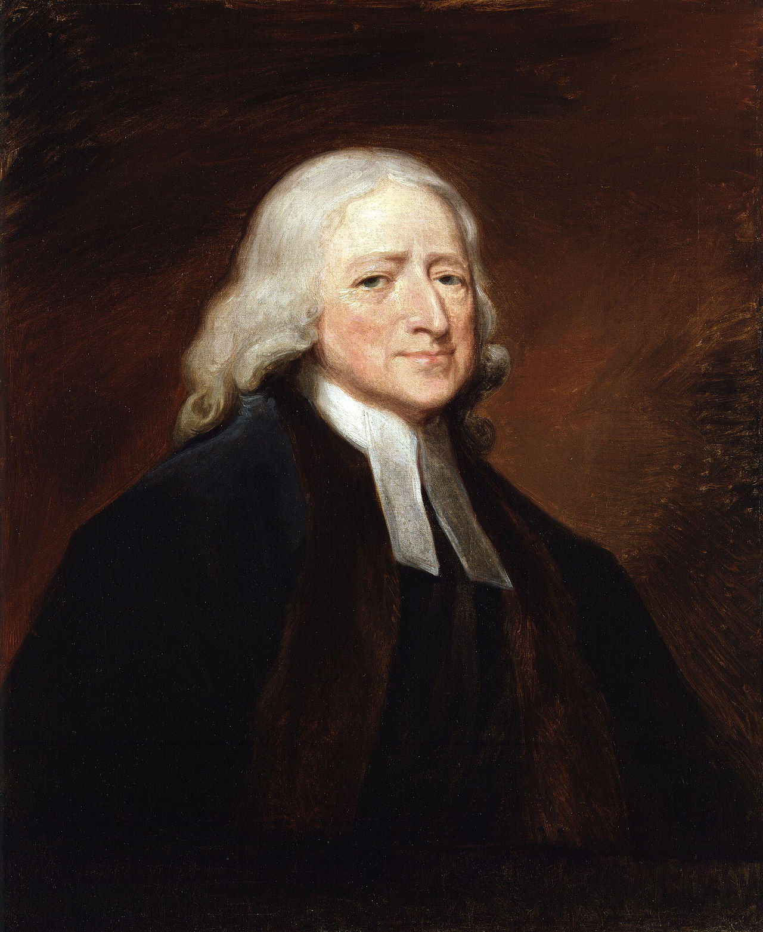
1:13-25
example ~ hypogrammos – under + write
“To sign so as to assume liability in case of specified losses; to insure.”
“The readiest way to escape from our sufferings is, to be willing they should endure as long as God pleases.”
John Wesley
(1703-1791)

Slide 25
1:13-25

Slide 26
1:13-25
If I feel like you’ve been rude to me
You’ll pull a gun on me
I’ll flame you on FB
I’ll pull a knife on you
You’ll hit me
I’ll key your car

Slide 27
1:13-25

Slide 28
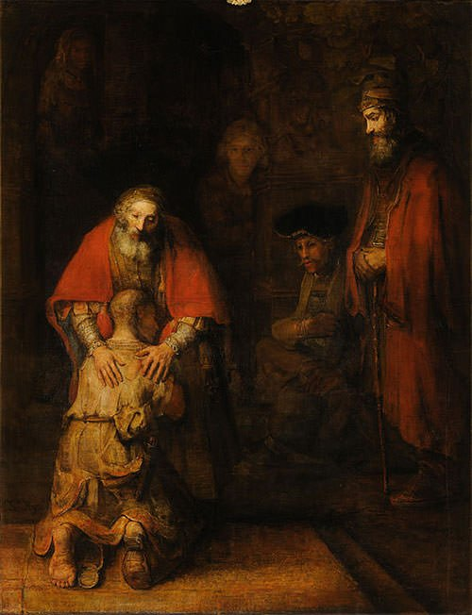
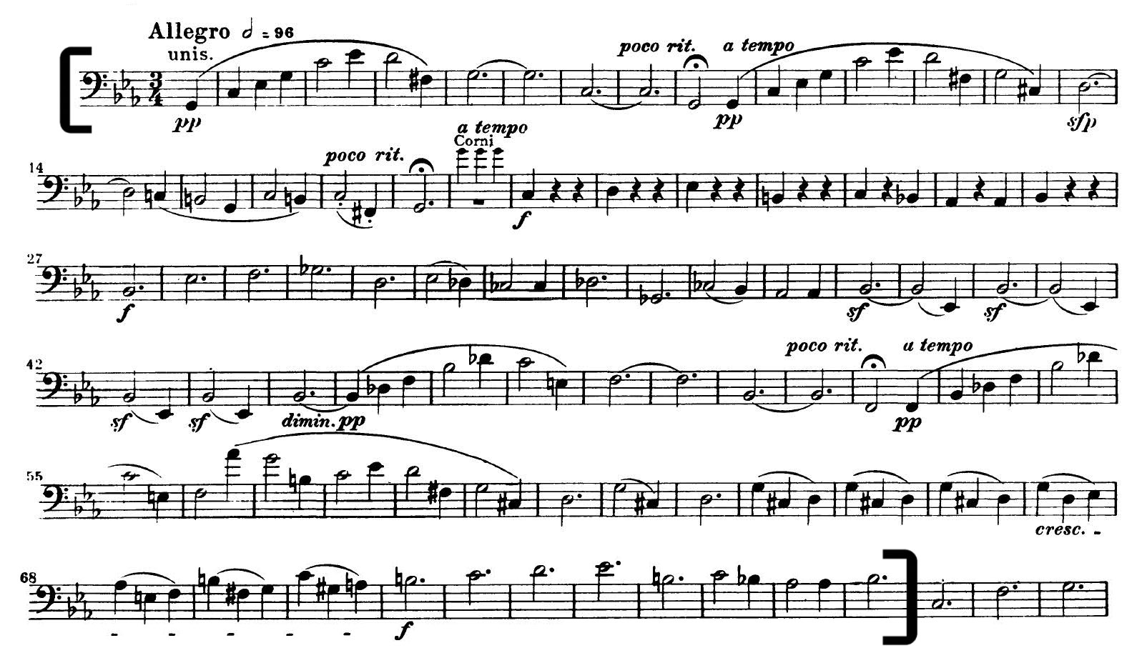
1:13-25
Beethoven’s “5th Symphony”
Rembrandt’s “Return of the Prodigal Son”

Slide 29
1:13-25
God’s holiness
God’s mercy

Slide 30
1:13-25

Slide 31
1:13-25
Overseer ~ episkopos – the true Bishop

Slide 32
1:13-25

